Slide 1
Arenathon
Team Luc & Gonzalo
GAM 400 / 450
first semester project

Slide 2
Team Luc & Gonzalo
Luc Kadletz
GAM 400
Splitting time with Sand Garden until GDC
Gonzalo Rojo
GAM 450

Slide 3
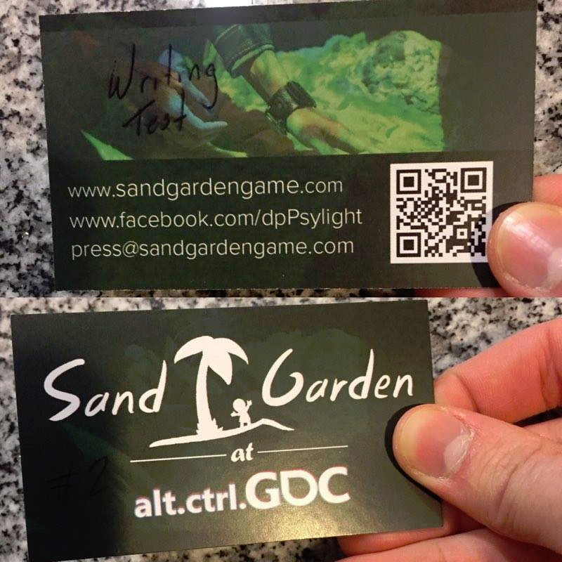
Sand Garden
IT-related blocks for 3 weeks . . .
but we’re good to go now
In the next two weeks:
Critical bugfixes
Game flow optimization
Minor UI changes
Streamline rig setup
(2 hour setup window!)
Business cards by Dakota Galayde

Slide 4
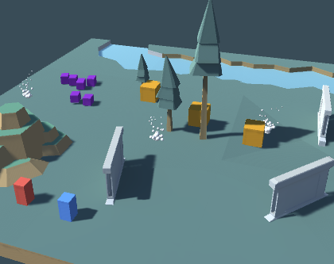
Arenathon Overview
Simple 1-2 player arcade action brawler
First Semester Project in Unity
Gameplay programmer portfolio piece
Demonstrate breadth of skill with limited art & time
Emphasis on gameplay mechanics, AI, and technical polish

Slide 5
Demo

Slide 6
Features
Combat framework
Leverages Unity’s prefabs to modularize and reuse code as much as possible
Abilities use custom messaging system
Allows us to make and reuse abilities with minimal code editing
Versatile AI system
Shared interface for AI and players for efficient code reuse
Allows for quick recombination of movement & attack behaviors

Slide 7
Arenathon Gameplay Goals
Arcade style waves of enemies
Game mode customization options
Friendly Fire
Ability pool
High score system
Online leaderboards as a stretch goal
Polish and focus on gameplay

Slide 8
Thank you
Team Luc & Gonzalo
Arenathon

